Slide 1
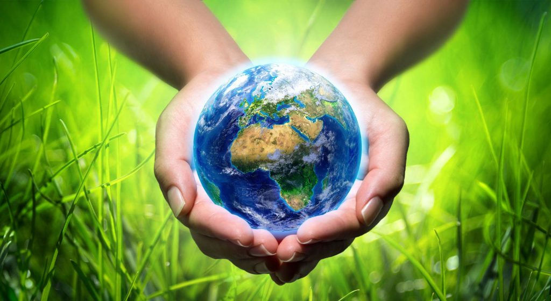
ECOLOGİCAL LİTERACY FOR SUSTAİNABLE LİVİNG

Slide 2
Our Project was carried out twice in Etimesgut district of Ankara province

Slide 3
Our Project was awarded financial support twice by TÜBİTAK

Slide 4
GENERAL OBJECTİVES OF THE PROJECT
With this Project, the participants;
Develop a positive attitude, value and understanding towards nature.
Understanding the natural processes that make life possible on earth,
To learn the science of the nature/world and continue their lives in this direction,

Slide 5
Specific Objectives Of The Project
To enable the participants to observe nature by doing and experiencing it personally
Raising awareness on ecology and nature
To ensure the recognision of the living environment and to develop a conscious perspective to protect nature

Slide 6
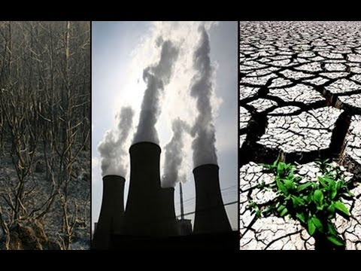
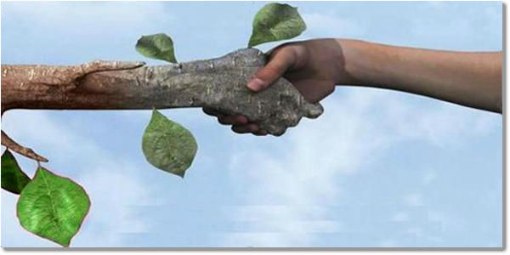
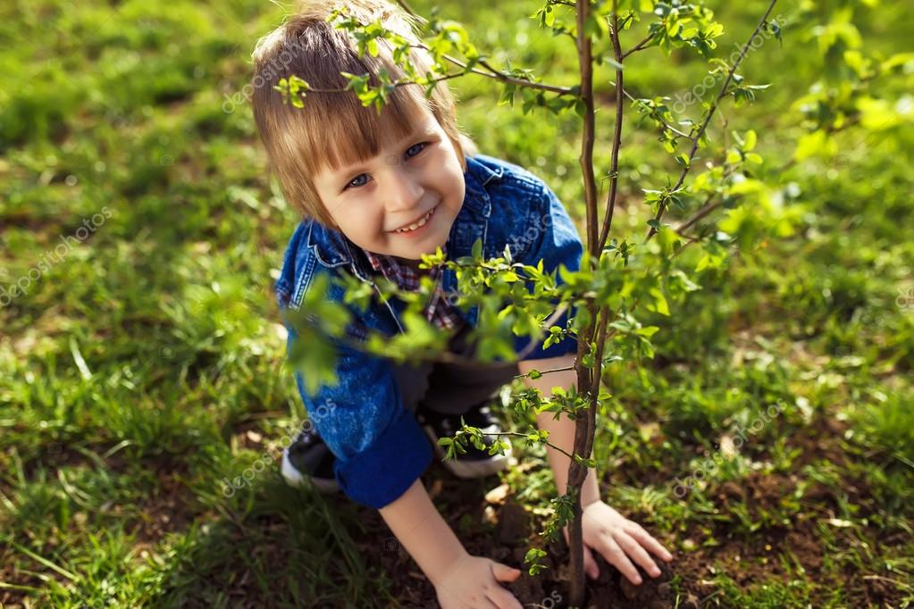
Specific Objectives Of The Project
To raise awareness about the functioning of the ecosystem and the effects of humans on the ecosystem,
To contribute to the development of understanding nature - human - society relationships and generating solutions to problems in relationships,
To ensure that they develop positive attitudes towards nature by understanding the language of nature,

Slide 7
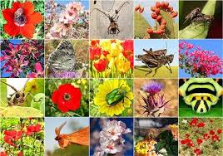
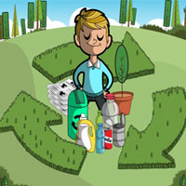
Specific Objectives Of The Project
Raising awareness about biodiversity
To protect the ecological balance and develop life awareness for a sustainable environment.

Slide 8
Target Audience of the Project
Preschool
teachers
Preschool children
(48-66 months)

Slide 9
Supporting Institutions
Grand National Assembly of Turkey
Turkey Combating Soil Erosion, Reforestation and Habitats (TEMA) Ankara Representative
Kızılcahamam District Health Directorate
Kızılcahamam Municipality

Slide 10
FİELDWORK AND PROMOTİONAL ACTİVİTİES
PREPARATİON OF TRAİNİNG PROGRAM AND MATERİALS
EDUCATİON OF CHİLDREN
MONITORING-EVALUATION AND REPORTING
STUDIES TO INCREASE THE COMMON EFFECT
TEACHER TRAİNİNG
Project Activities

Slide 11
EDUCATION PROGRAM CALENDAR
Teacher Training
31 August -05 September 2020 ( Kızılcahamam Patalya Hotel, Soğuksu Milli Parkı, Işık Mountain, Çamlıdere Geopark, Black Lake)
Education of Children
05 - 09 October 2020 ( Eymir Lake and its surroundings)
09-22 October 2020 (TBMM-Assembly Garden)
12 - 21 October2020 ( School Garden)

Slide 12
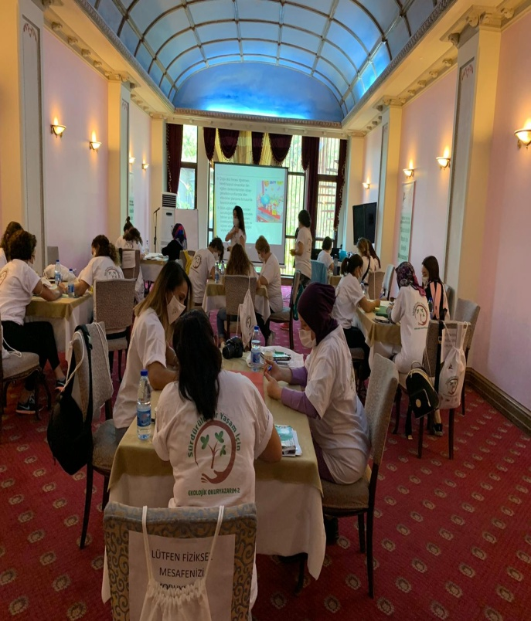
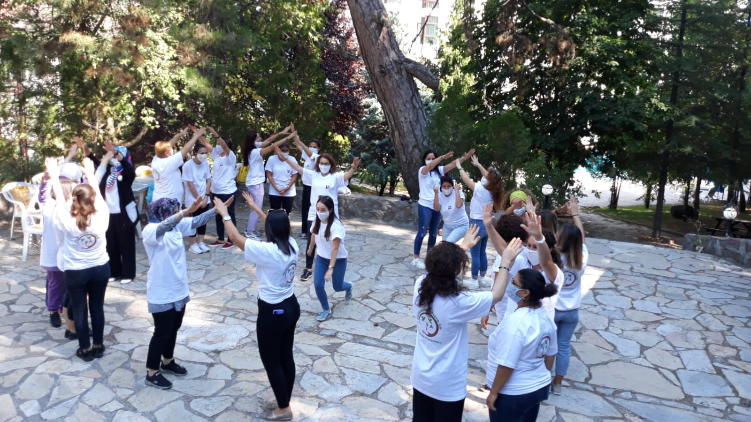
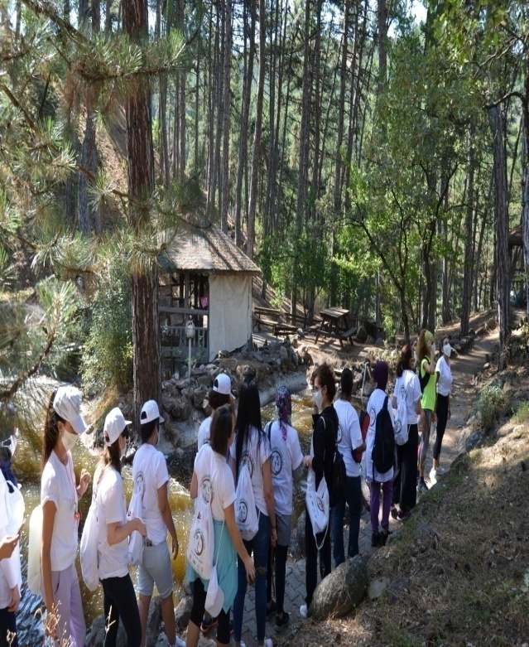
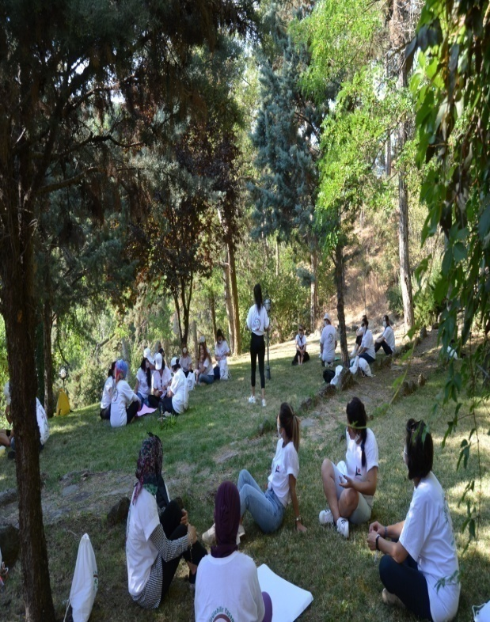
TEACHERS’ ACTİVİTY PROGRAM
First Day Activities
Information about the project
Natural Sicience Education İn Preschool
Creative Ways to Connect Chidren with Nature
Taechers Meet with Nature

Slide 13
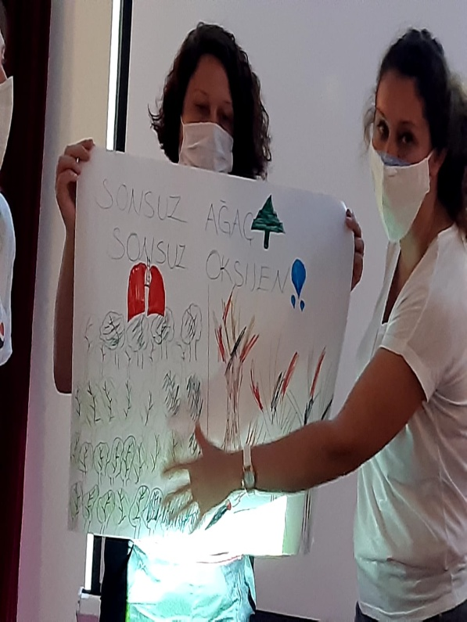
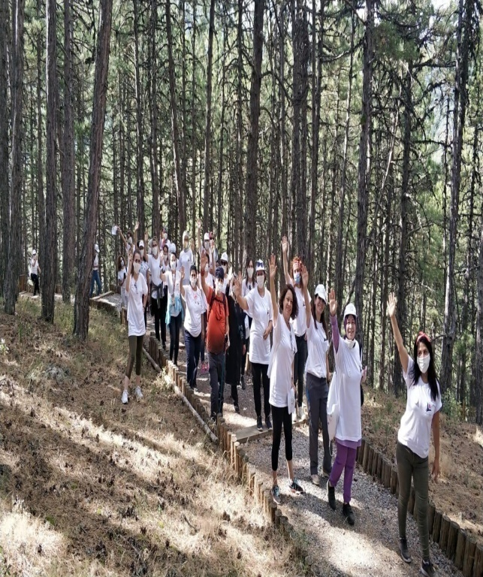
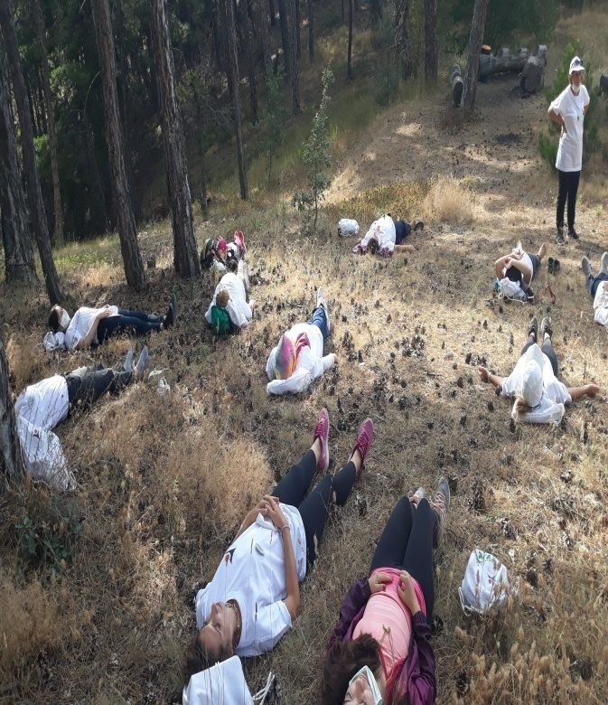
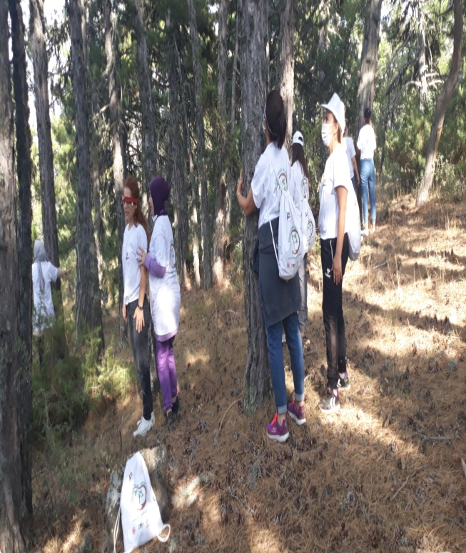
TEACHERS’ ACTİVİTY PROGRAM
Second Day Activities
Why Ecological Literacy (Ecoliteracy)
Ekological Footprint
Ekological Literacy and Basic Principles of Ecology
Discovering Soğuksu Nationa Park
Discovering Nature

Slide 14
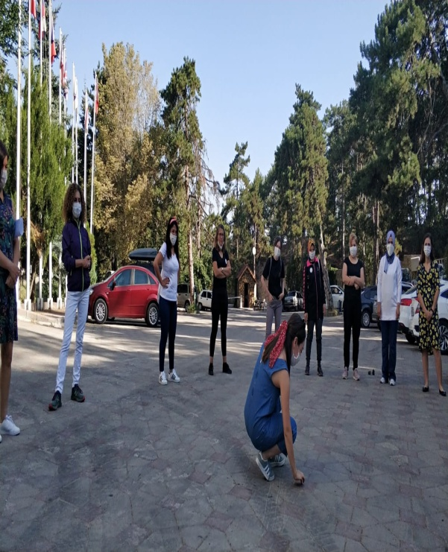
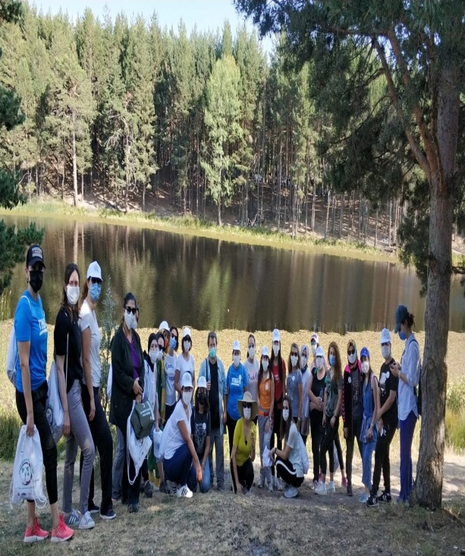
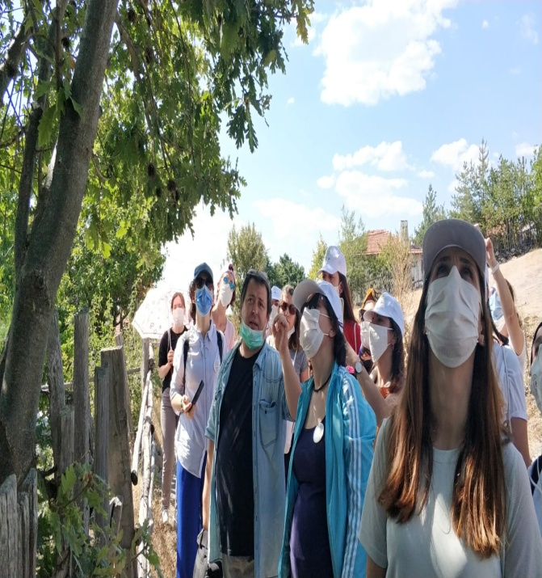
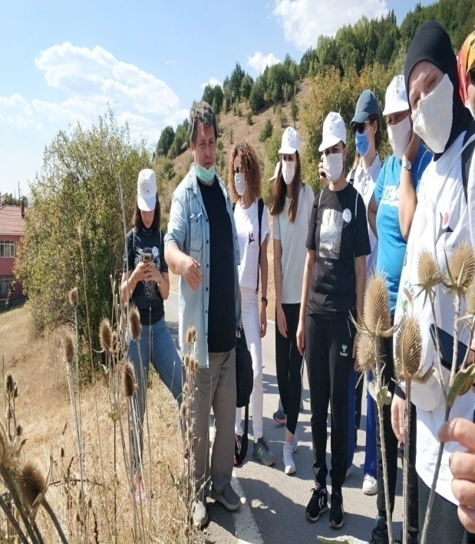
TEACHERS’ ACTİVİTY PROGRAM
Third Day Activities
Listening to Nature
Ecosystem and the Plant Kingtom
Climate Change and the Plant Kingtom
Işık Mountain Habitats
Life in the Dead Tree

Slide 15
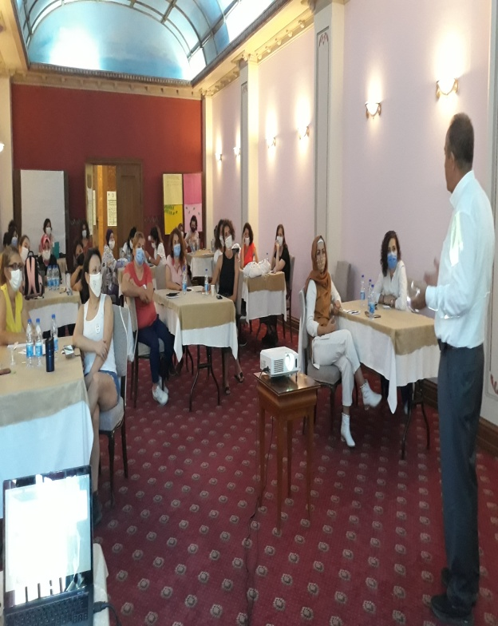
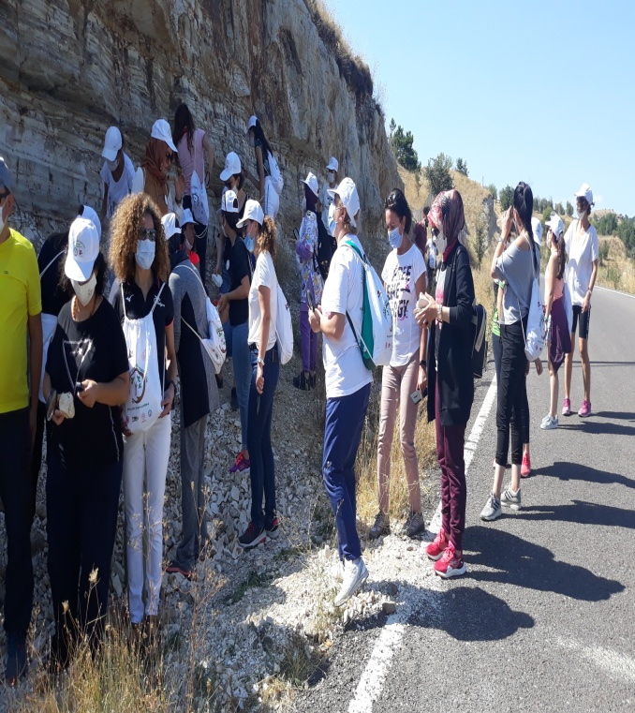
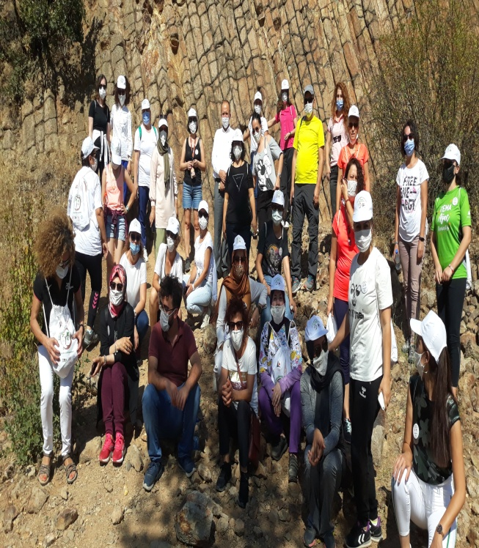
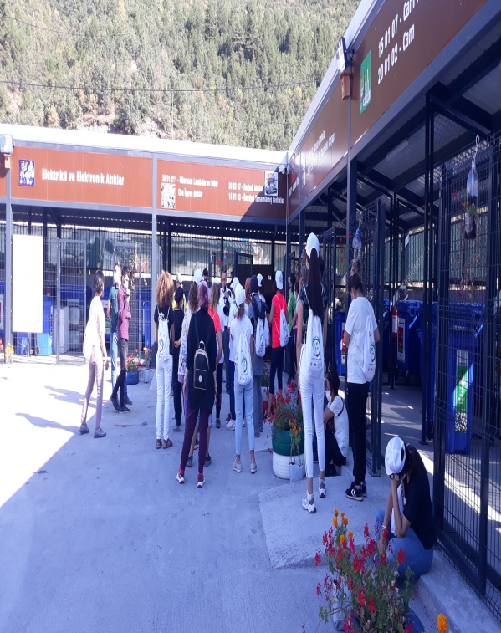
TEACHERS’ ACTİVİTY PROGRAM
Fourth Day Activities
What is Soil? What does it consist of?
How is it Formed? Why Is It Important
Observing Typical Earth Sample?

Slide 16
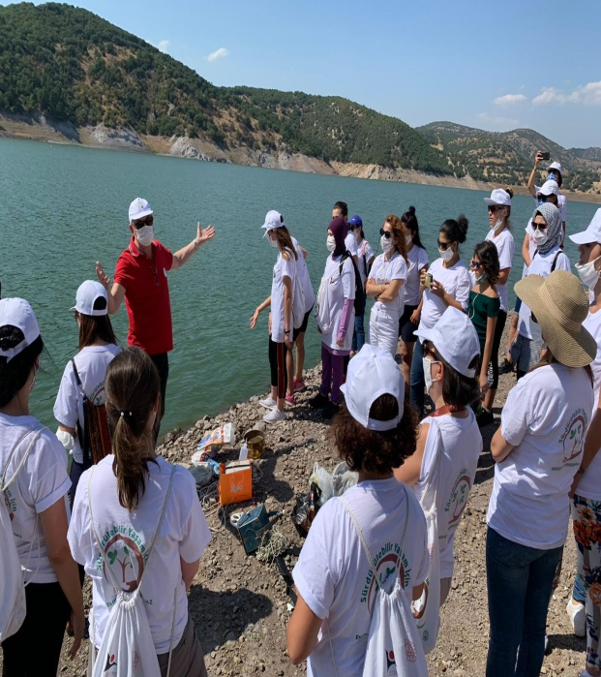
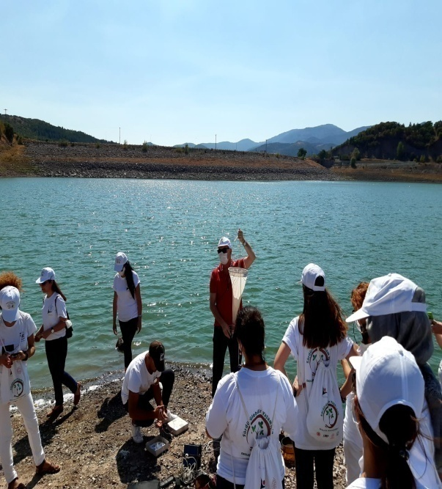
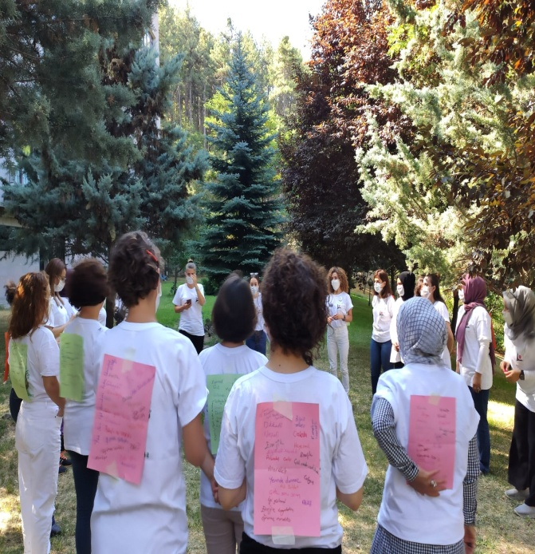
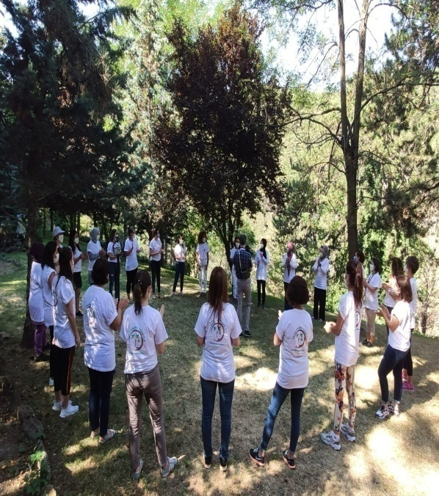
TEACHERS’ ACTİVİTY PROGRAM
Fifth Day Activities
How Is Water Formed? Does the Water in Our World End?
Planing Nature Education for Preschool Children?
Palctonic and Benthic Organisms Living in the Karagöl Lake
Come on Fish (Karagöl Lake)

Slide 17
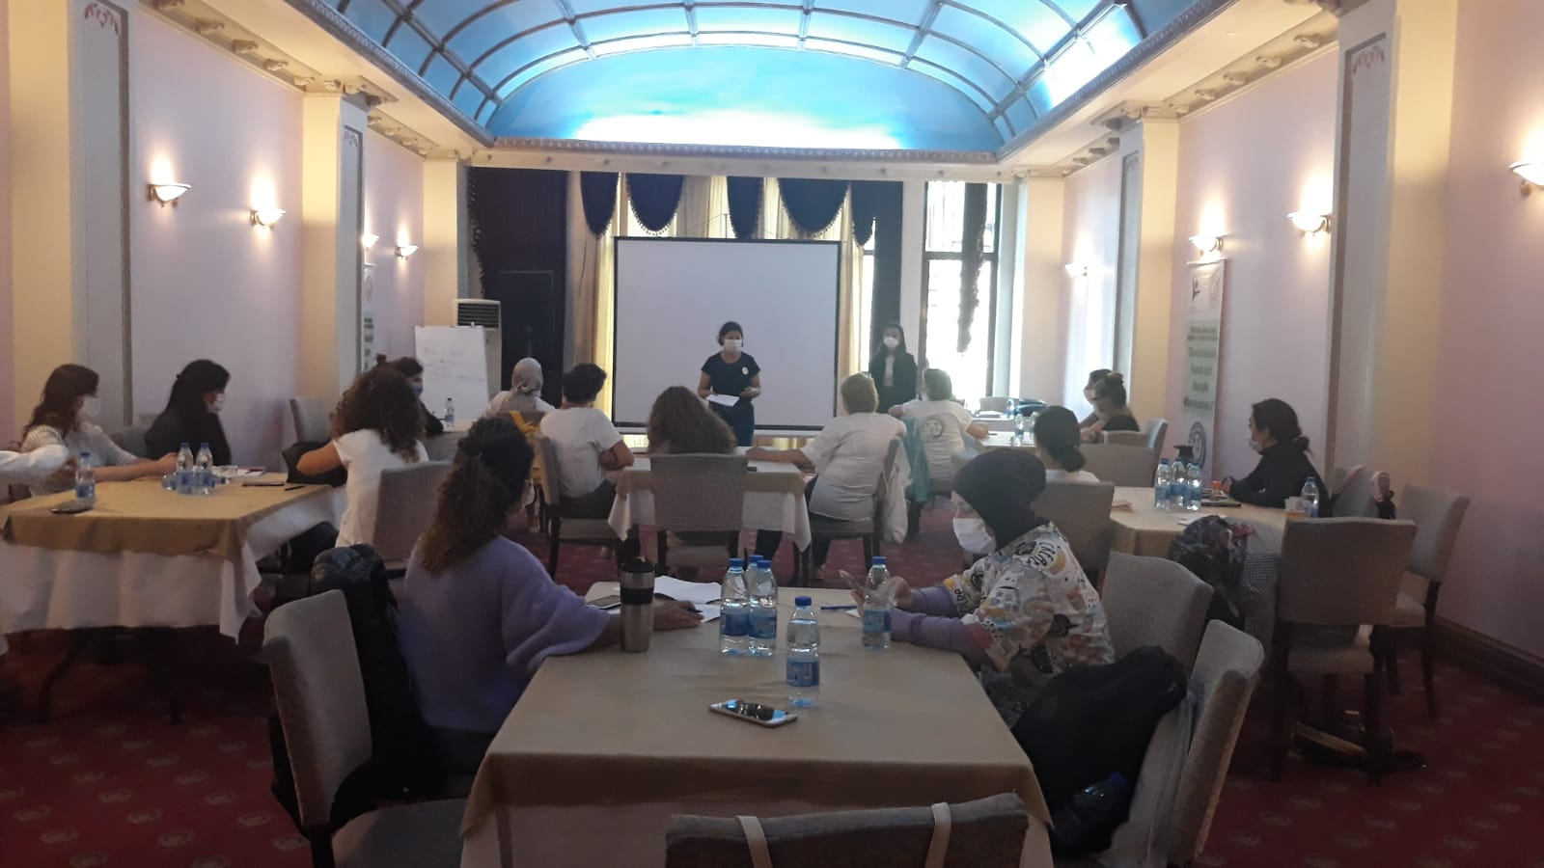
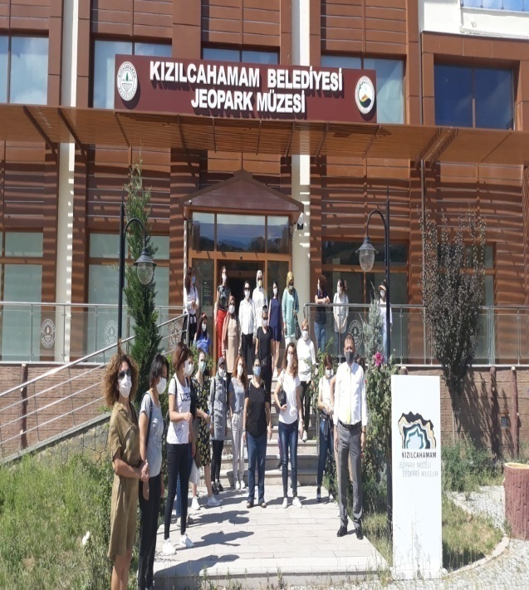
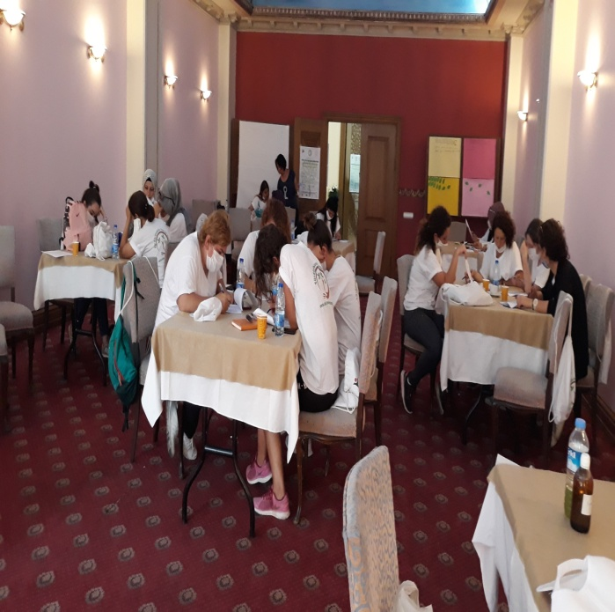
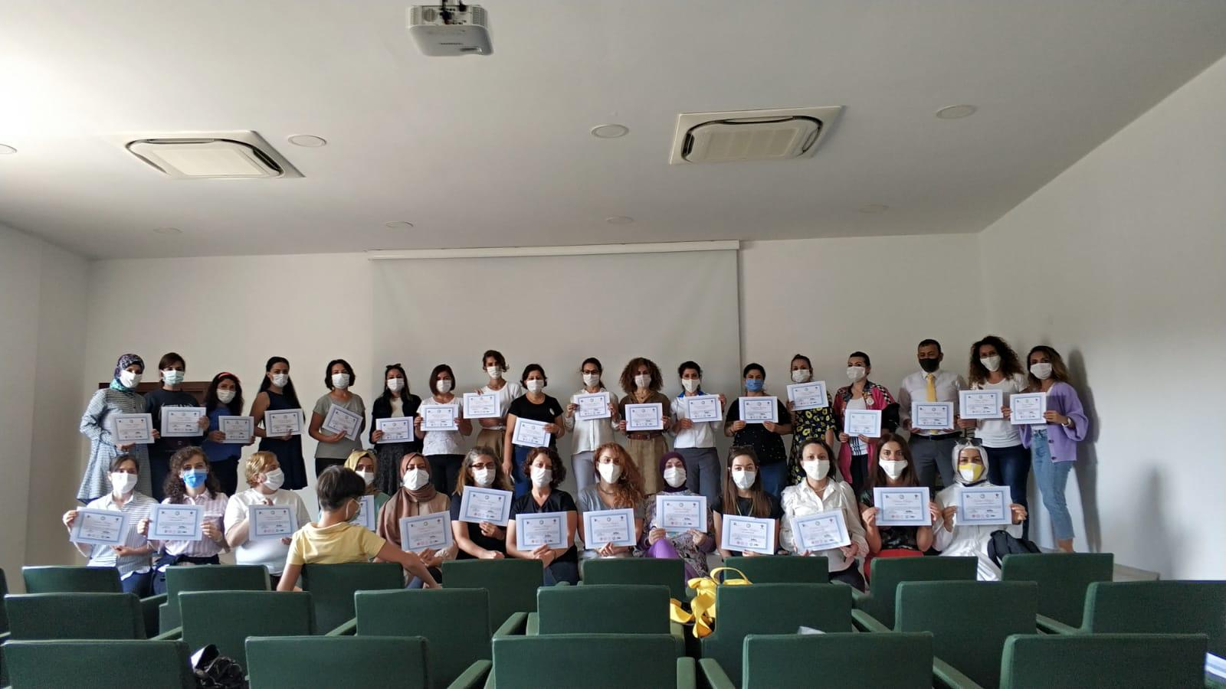
TEACHERS’ ACTİVİTY PROGRAM Sixth Day Activities
What Am I thinking?
Learning Fluently
Sustainable Consumption Habits

Slide 18
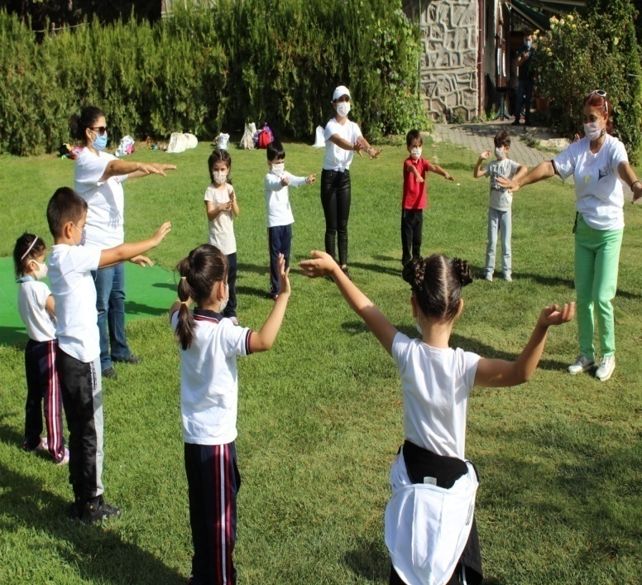
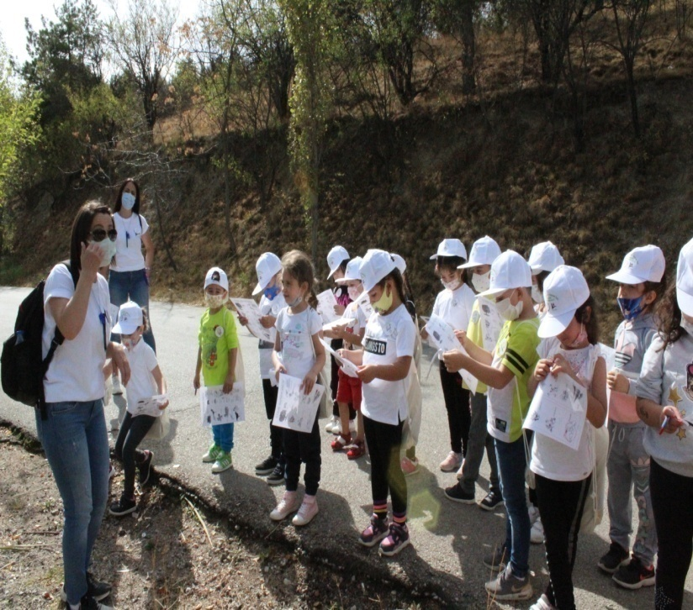
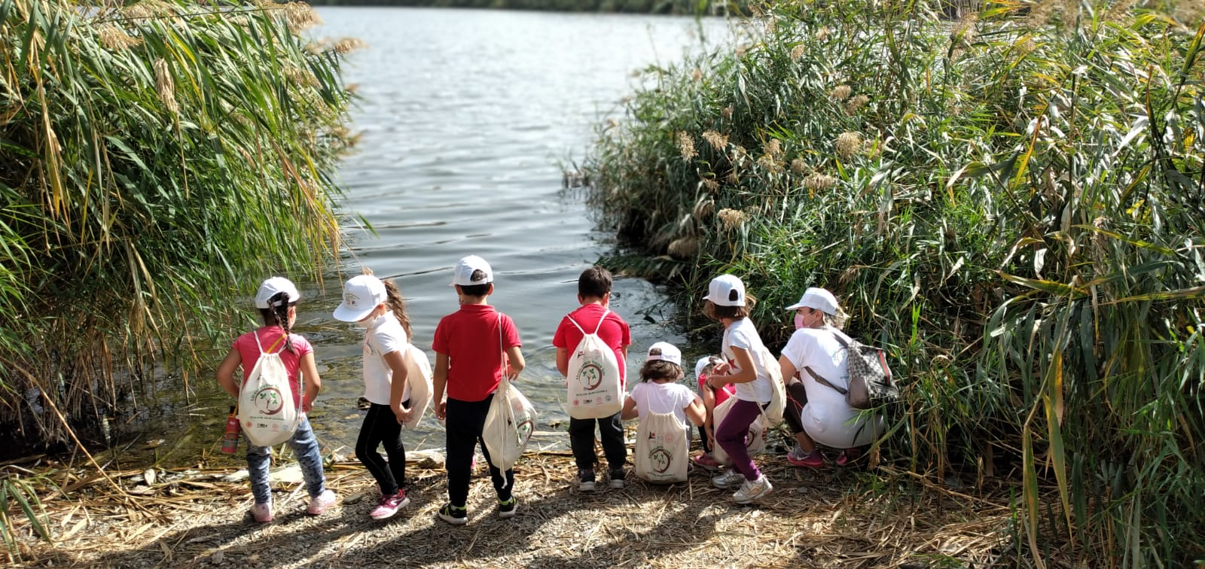
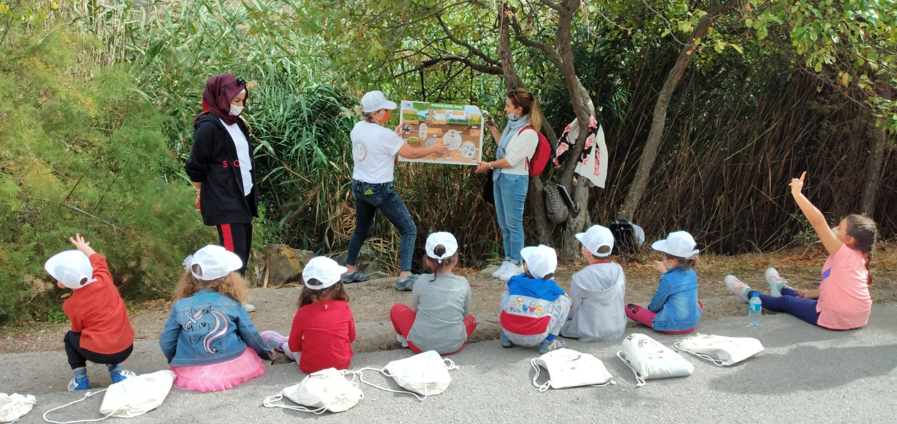
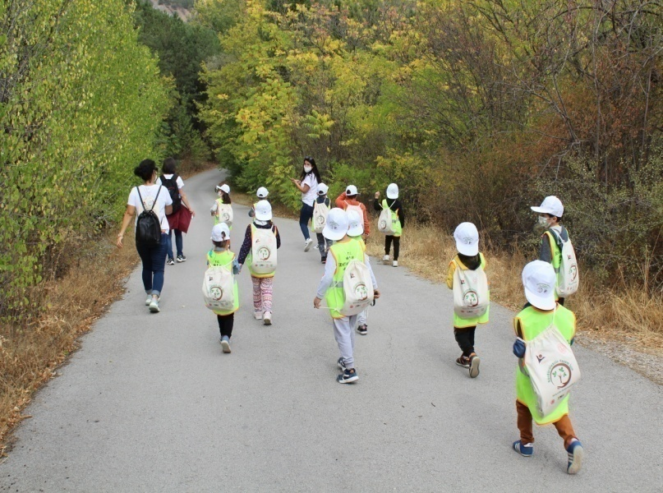
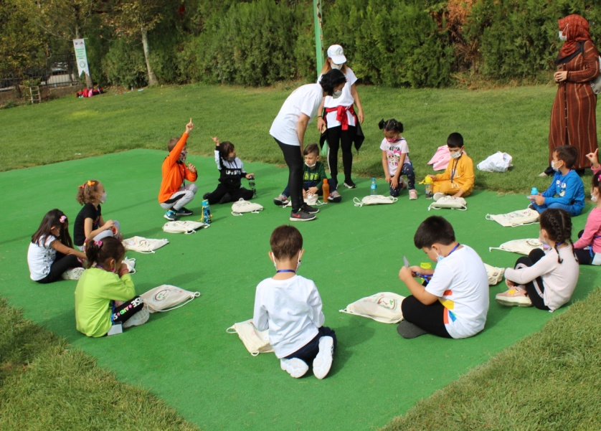
CHİLDREN’S ACTİVİTY PROGRAM Eymir Lake Activities

Slide 19
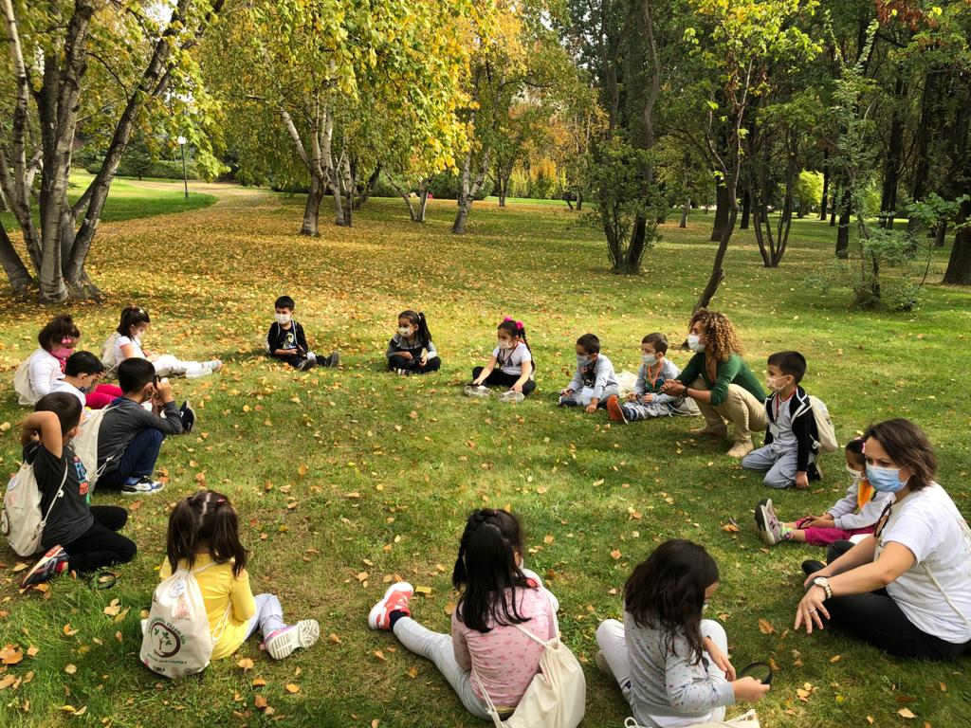
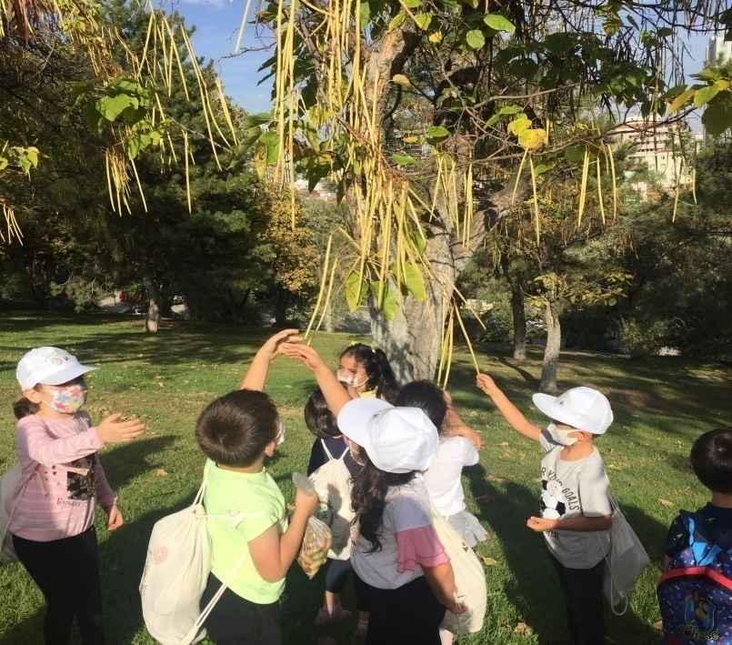
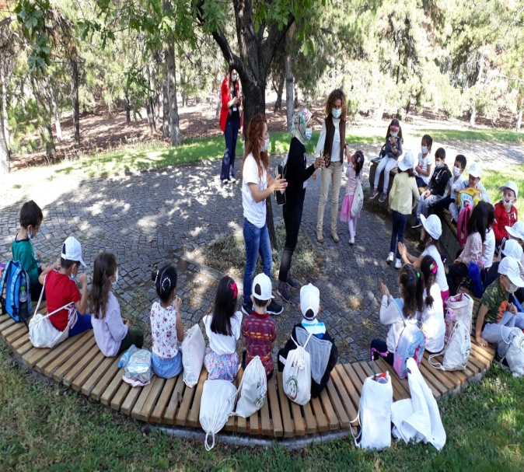
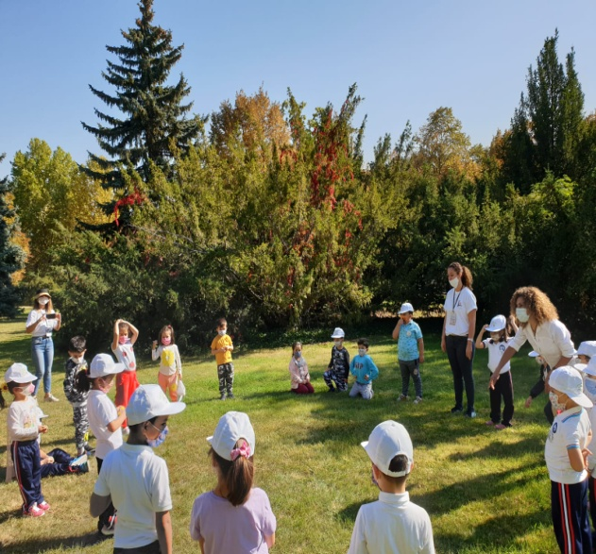
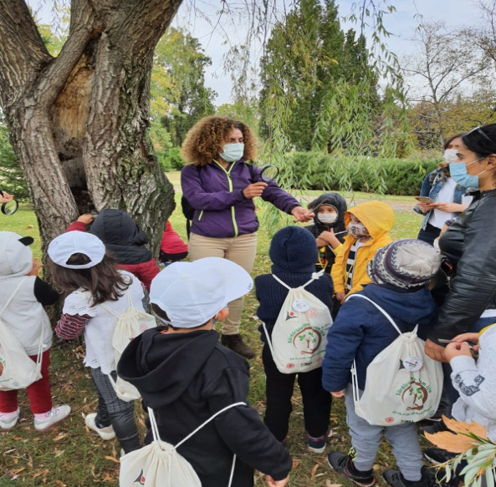
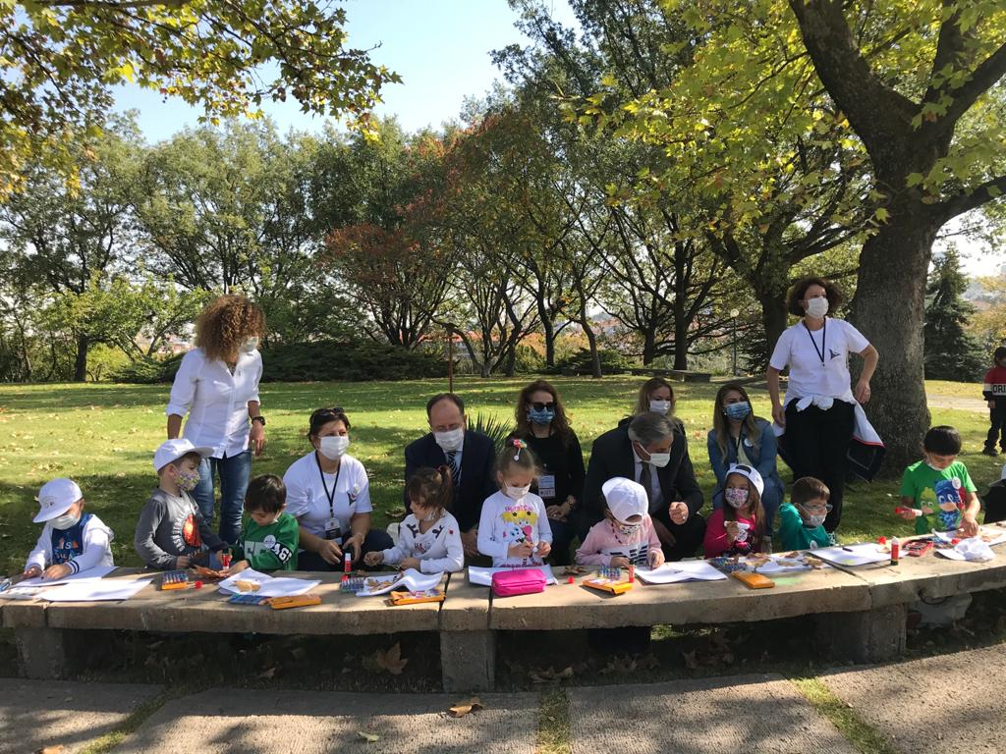
CHİLDREN’S ACTİVİTY PROGRAM TBMM (Parliament) Garden Activities

Slide 20
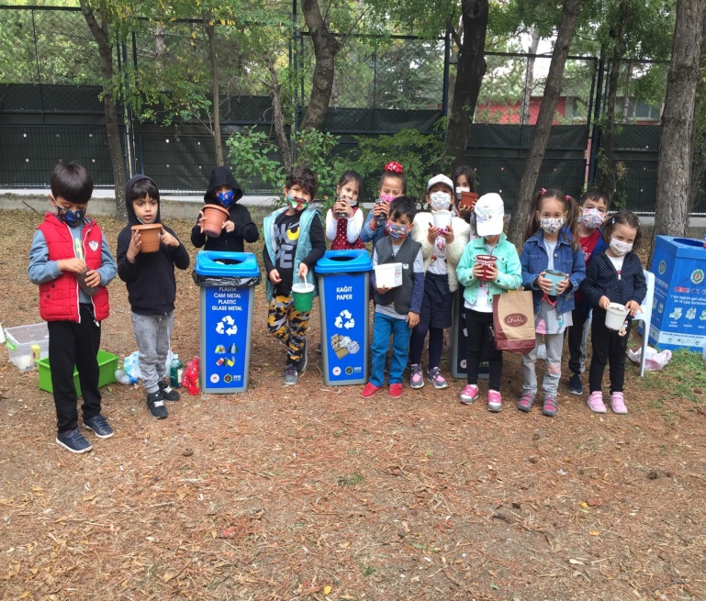
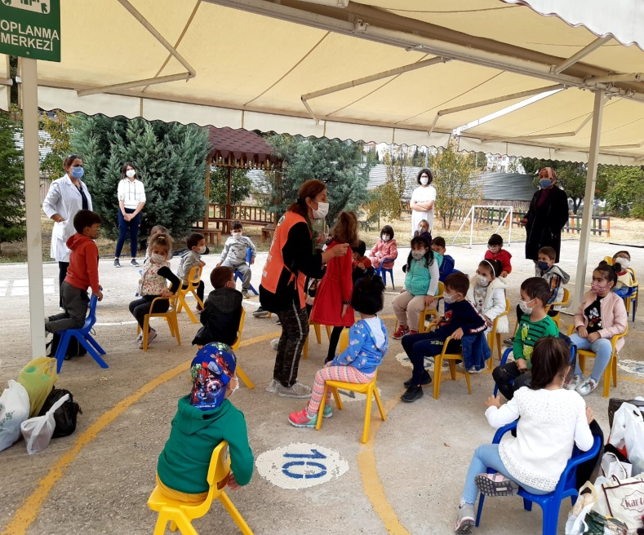
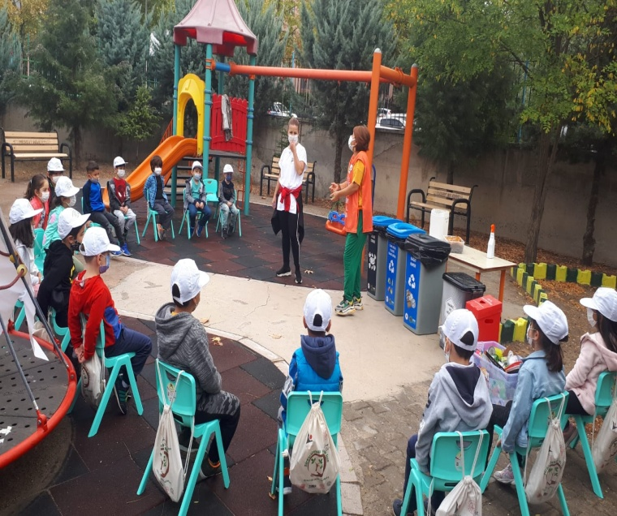
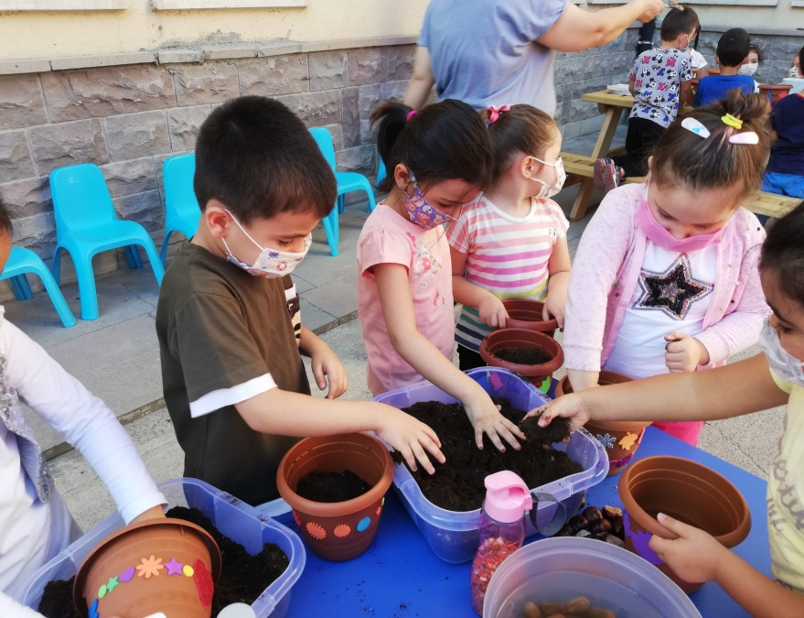
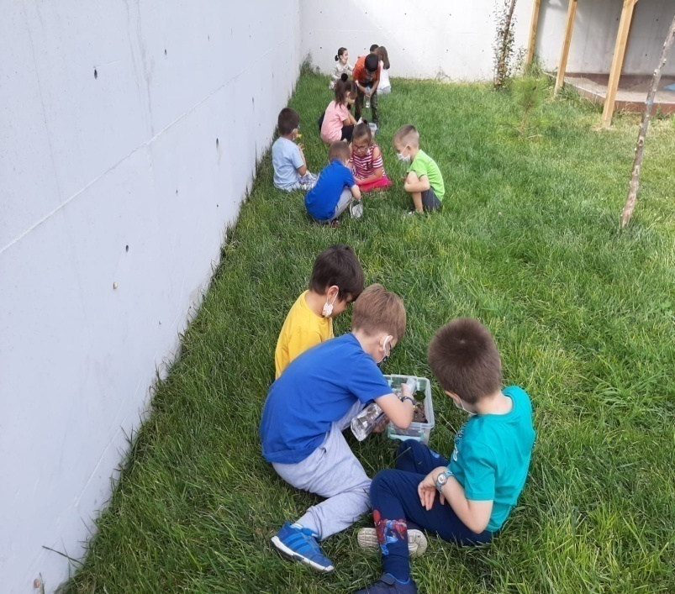
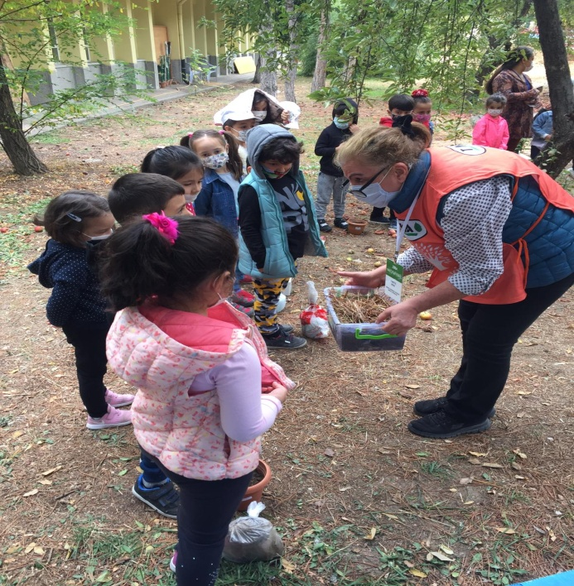
CHİLDREN’S ACTİVİTY PROGRAM School Garden Activities

Slide 21
METHODS AND TECHNIQUES USED IN EDUCATION
Group work,
Nature games,
Drama activities,
Experimental studies,
Poster works,
Travel observation activities,
Field studies,
Demonstration,
Fluent learning

Slide 22
STUDIES TO INCREASE THE WIDE EFFECT
The activities, videos and photos were shared with children, parents, teachers, academicians and all concerned via the www.ekolojikokuryazarim.com website, the My Ecological Literacy for Sustainable Life Facebook group and social media networks.
All of the activities were shared on the website. Thus, all stakeholders will be able to use the activities.
Participants were given a nature bag and some educational materials as gifts. Participants will be able to do the same or similar studies in different natural environments using these materials. Thus, sustainability and expansion will be achieved.

Slide 23
STUDIES TO INCREASE THE WIDE EFFECT
The awareness and dissemination of the project was achieved through the local and national press, radio and television programs using mass media.
The findings obtained from the project were published as papers in scientific meetings or as articles in scientific journals. In this way, it was ensured that activities and practices related to ecological literacy with children in early childhood were shared with large masses.
The families and close circles of teachers and students participating in the training were also informed about the project and the dissemination process was provided.

Slide 24
Project Deliverables
To raise awareness about ecological literacy,
Being a part of nature,
Learning to respect all living things in nature,
Protecting the right to life of all living things,
Noticing the problems in nature,
Developing suggestions for the solution of these problems,
Being part of the solutions

Slide 25
Project Deliverables
In addition to developing positive attitudes towards science, children's development was supported in terms of cognitive, affective, motor and social communication skills.
It is thought that this experience that students will gain in nature education will positively affect their academic preferences for the future years and their willingness to participate in such activities.

Slide 26
IN SUMMERY
According to the pre-test and post-test results conducted at the beginning and at the end of the project, it was revealed that all participants had an awareness of nature.
As the project team, we were happy to see that the project achieved its purpose.

Slide 27
THANKS

Slide 28
Kamer ÖZDEMİR
kamer0173@gmail.com

